Slide 1














Linear Feature Engineering
Presented by Gobinda & Ahmed

Slide 2






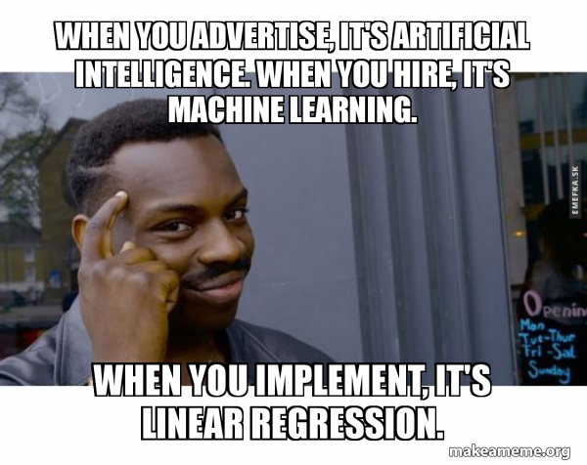








Slide 3
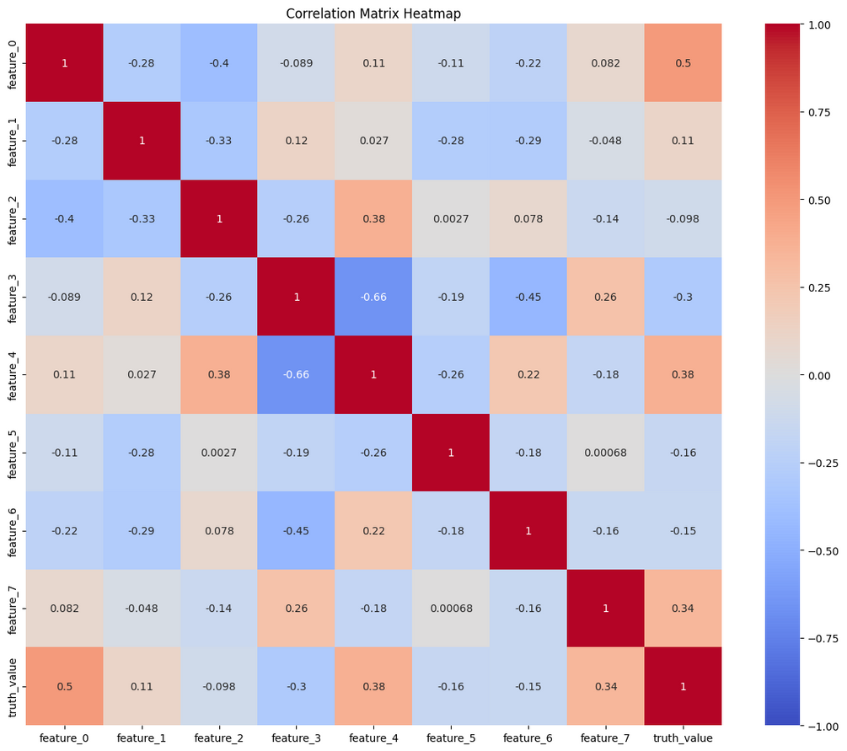
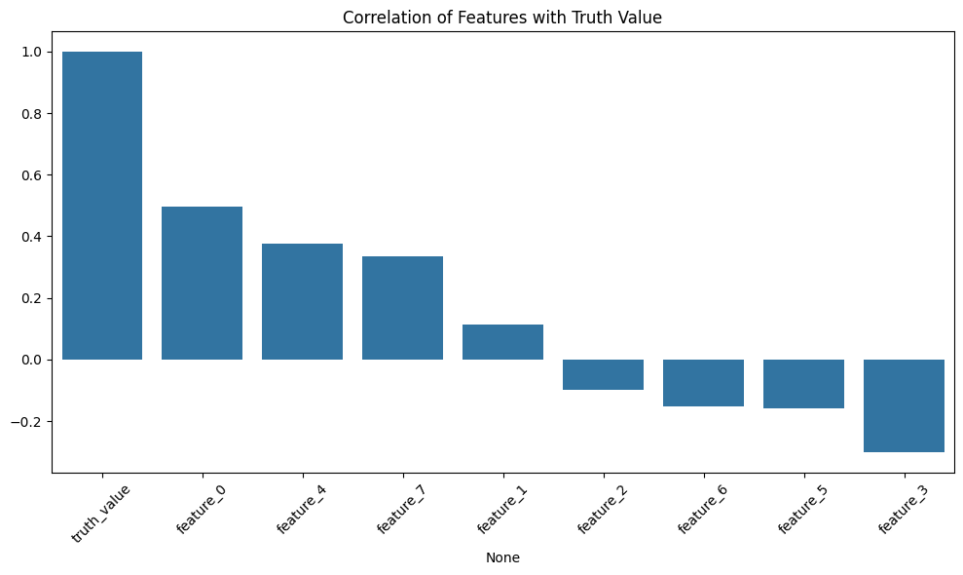
Data Analysis
Main tool Correlation

Slide 4
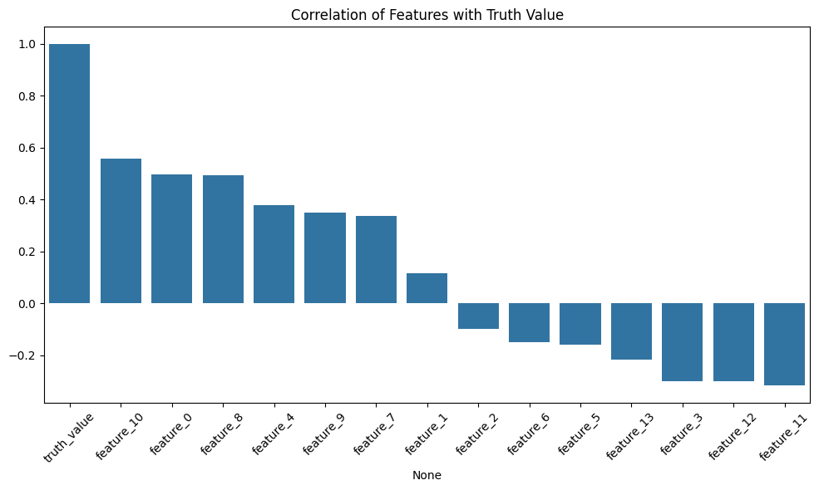
Feature Engineering
Logarithmic
Polynomial
Trigonometric
Reciprocal
Square Root

Slide 5
36.15
Evaluation
MSE as loss function
Least Squares linear regression
K-fold CrossValidation
Predicted Test Error
31.44
Training Error

Slide 6


Slide 7
Thank you!!

